Slide 1
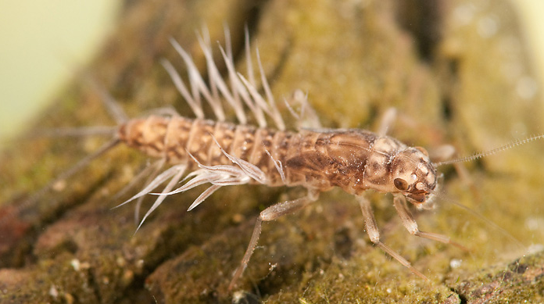
Introduction to aquatic insect ID
Domain Eukarya (Eukaryota)
Kingdom Animalia
Phylum Arthropoda
Subphylum Hexapoda
Class Insecta
Order Ephemeroptera
Family Ephemeridae
Genus Hexagenia
Species limbata

Slide 2
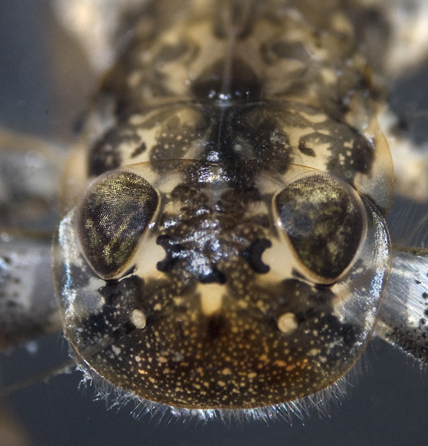
Why macroinvertebrates?
Introduction
Medium to long life spans (several weeks to several years)
Little mobility (good indicator of local conditions)
Very important trophic link
Very important link between ecosystems
River “health” video

Slide 3
Introduction to aquatic insect taxonomy
Introduction
Domain Eukarya (Eukaryota)
Kingdom Animalia
Phylum Arthropoda
Subphylum Hexapoda
Class Insecta
Order Ephemeroptera
Family Ephemeridae
Genus Hexagenia
Species limbata

Slide 4
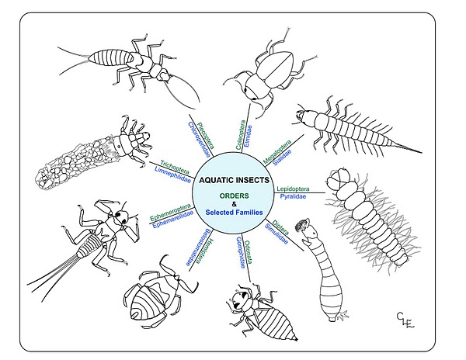
Orders

Slide 5
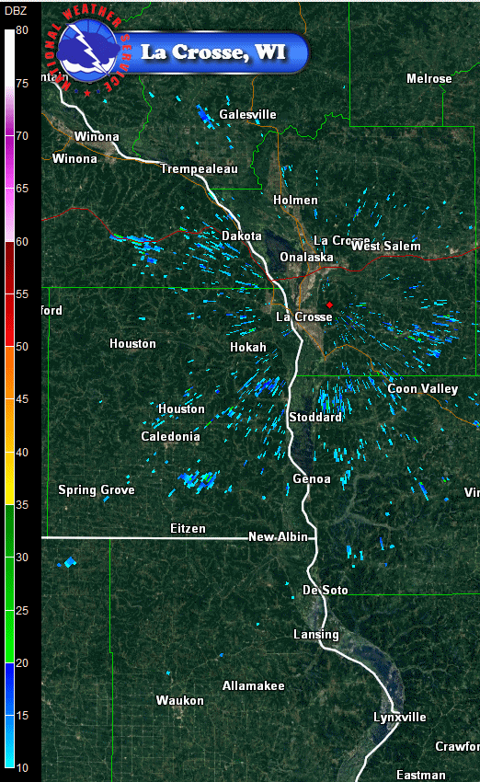
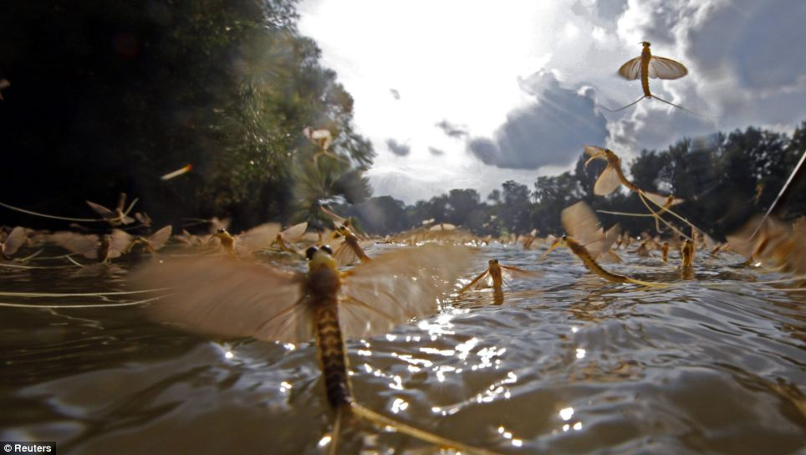
Life Stages
To grow, must shed exoskeleton (ecdysis)
Instar – stages inbetween ecdyses
Most insects have 4 to 6 instars
Terminal instar emerges into adult form

Slide 6
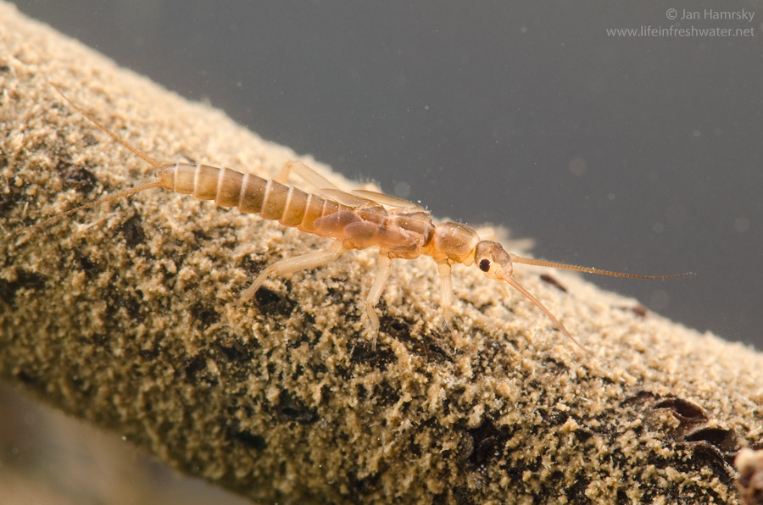
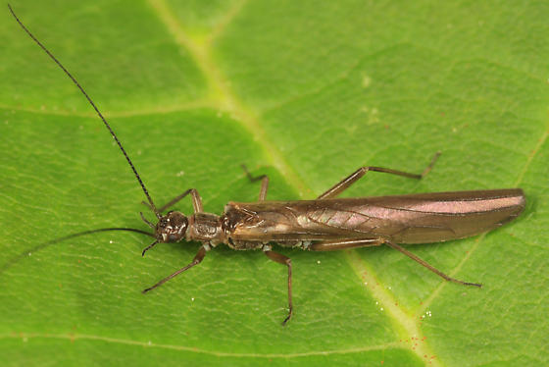
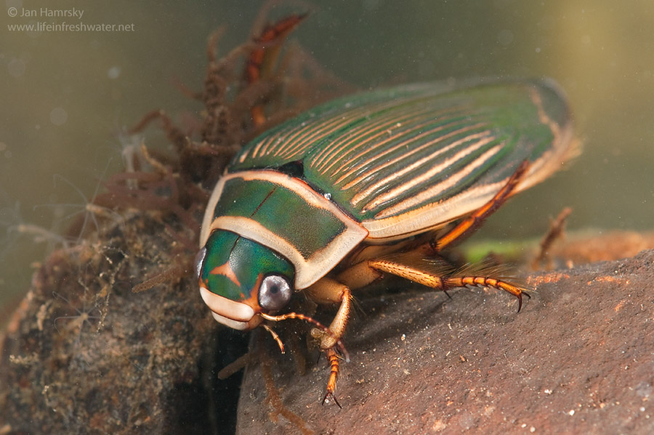
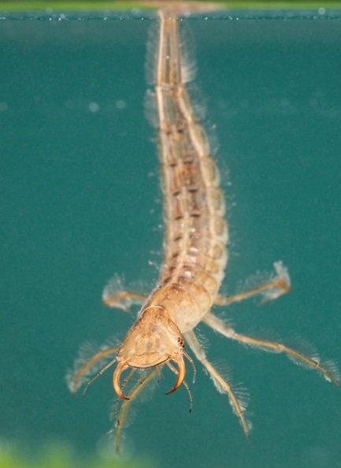
Life Stages
Hemimetabolous
Holometabolous

Slide 7
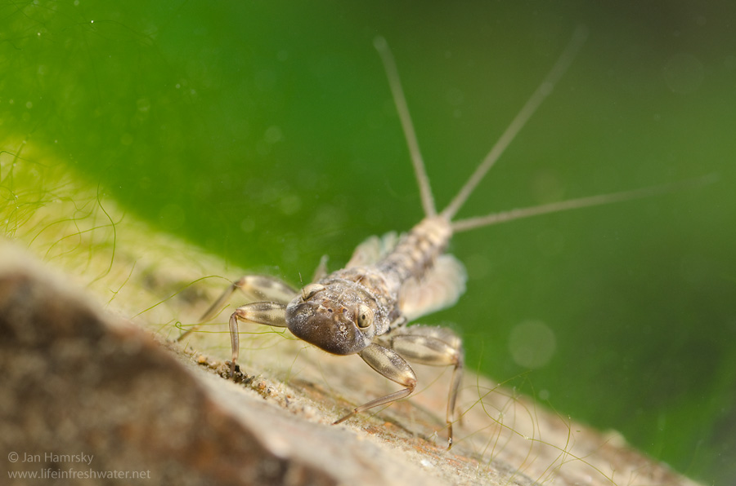
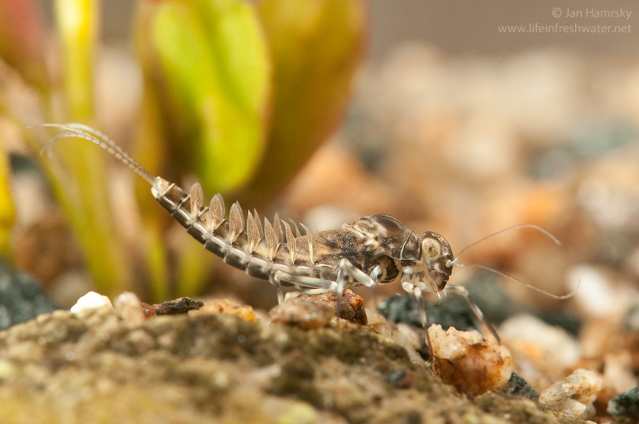
Ephemeroptera (mayflies)
3 tails
1 tarsal claw

Slide 8
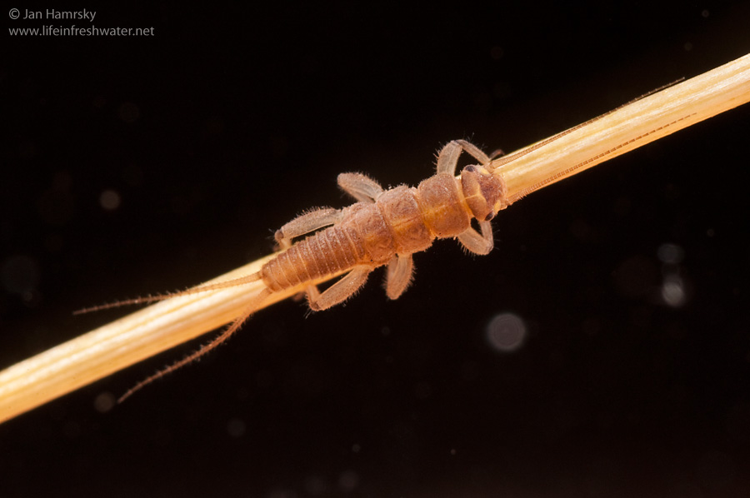
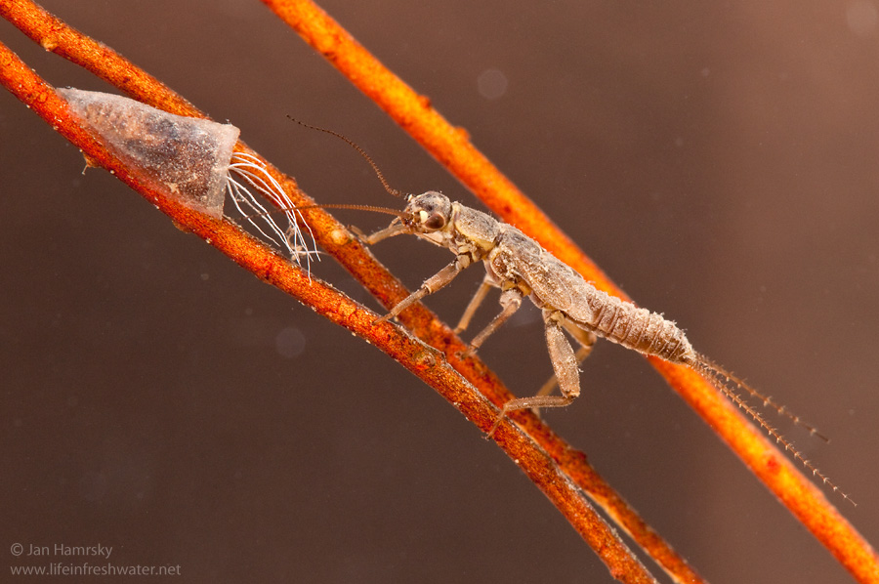
Plecoptera (stoneflies)
2 tarsal claws
2 tails

Slide 9
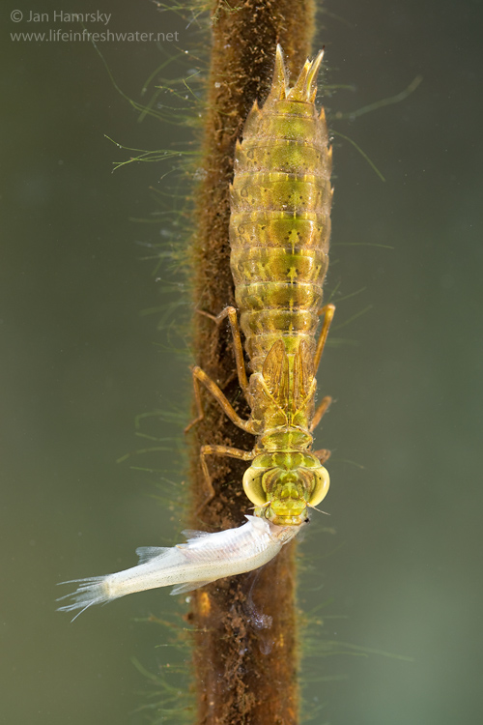
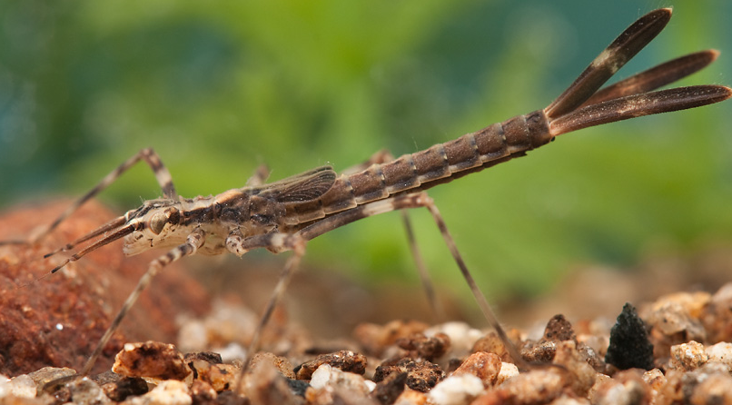
Odonata (dragonflies & damselflies)
Hinged mouth
Hunting

Slide 10
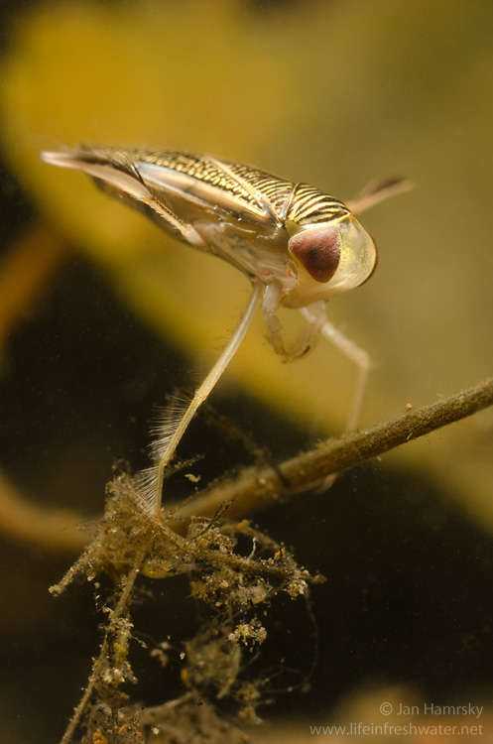
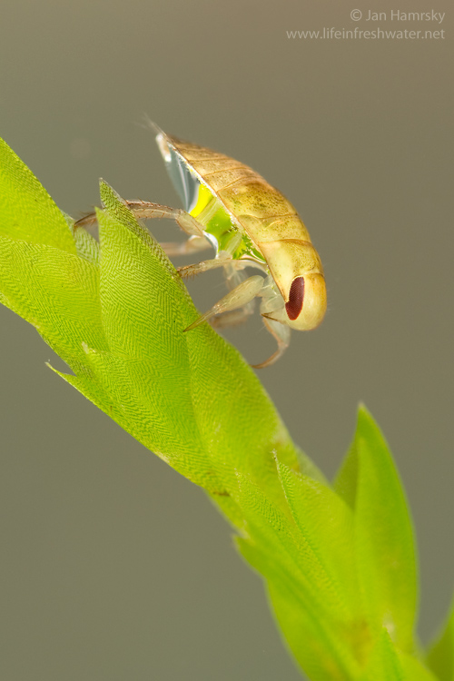
Hemiptera (true bugs)
Piercing/sucking mouthparts (i.e. rostrum)

Slide 11
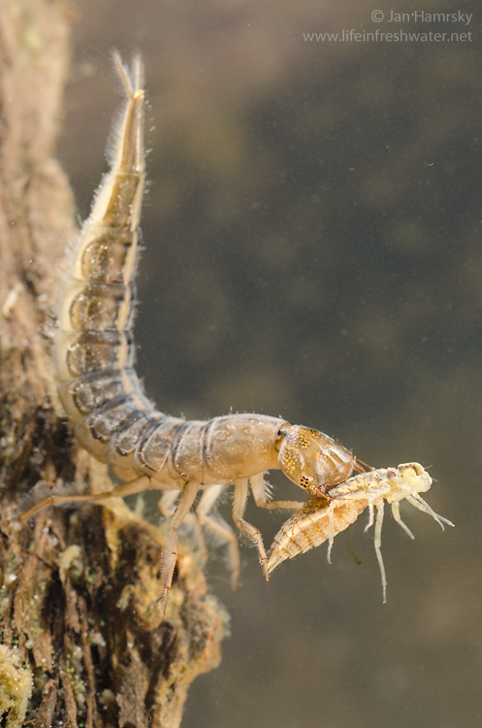
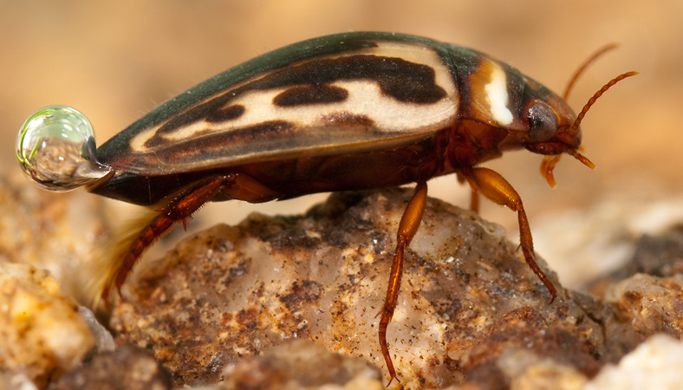
Coleoptera (beetles)
True, jointed legs (3 pairs, no prolegs)
Hard wing coverings
Has movable mouthparts (NO rostrum)

Slide 12
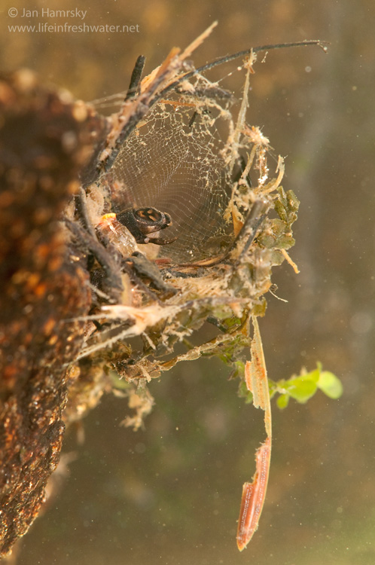
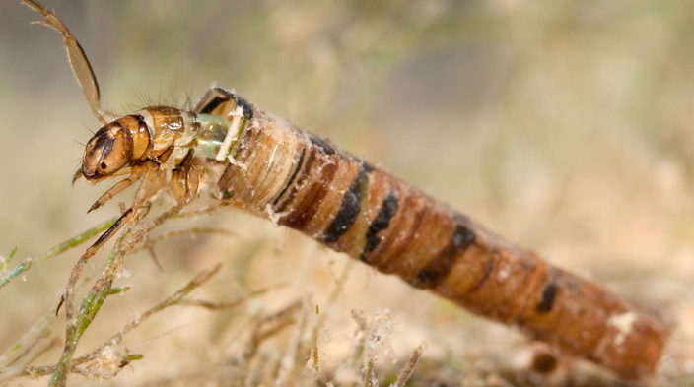
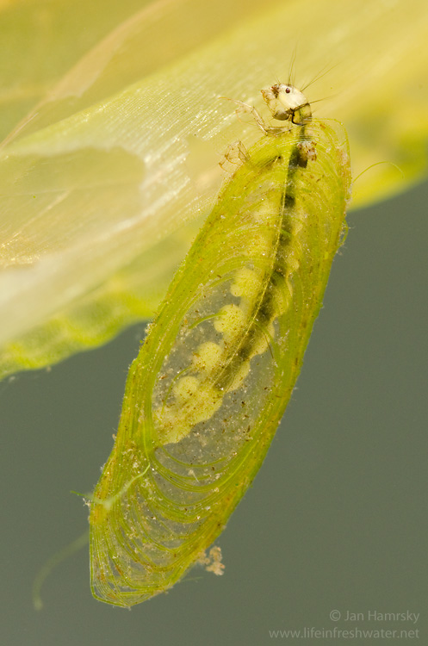
Trichoptera (caddisflies)
Pair of strong hooks on end segment
Often build cases

Slide 13
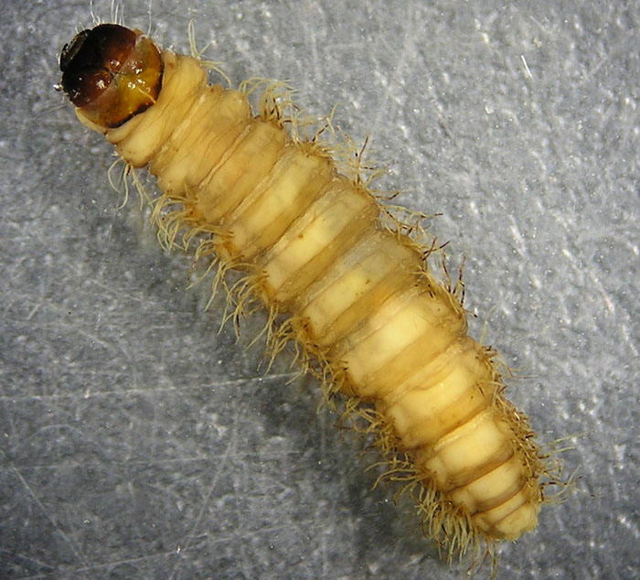
Lepidoptera (moths)
3 legs
Pairs of prolegs on abdomen with crochets

Slide 14
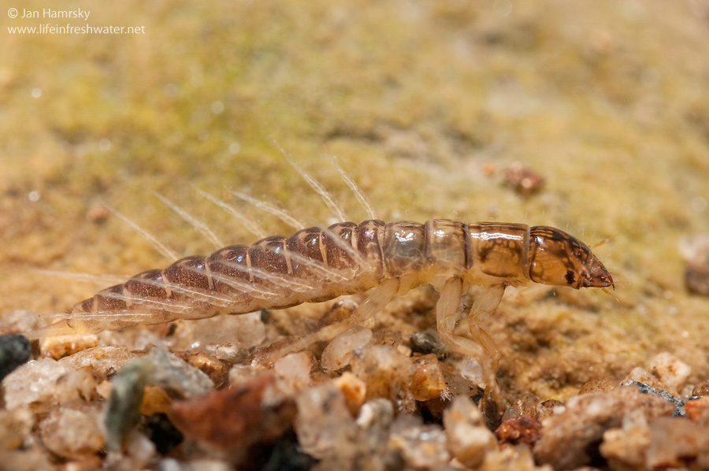
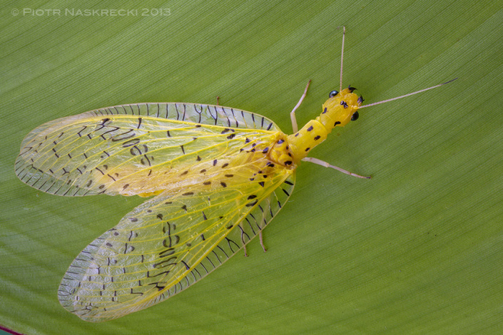
Megaloptera (dobsonflies & alderflies)
Lateral filaments on each abdominal segment

Slide 15
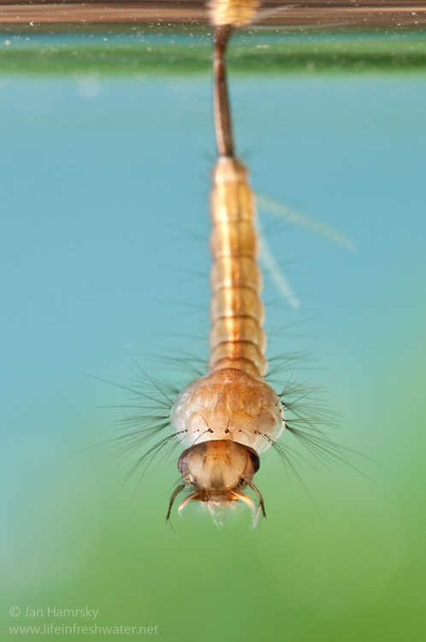
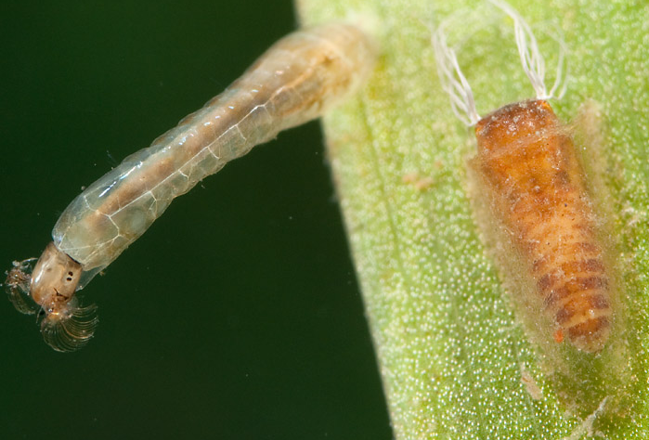
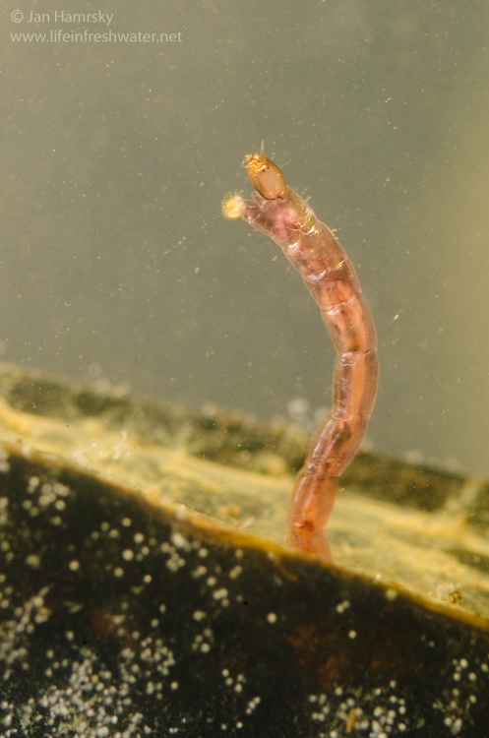
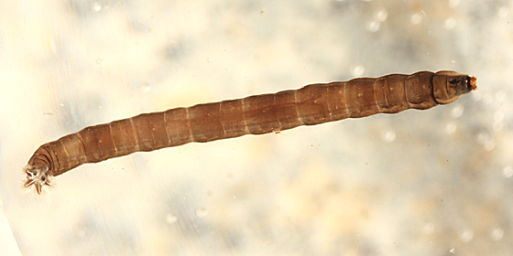
Diptera (true flies)

Slide 16

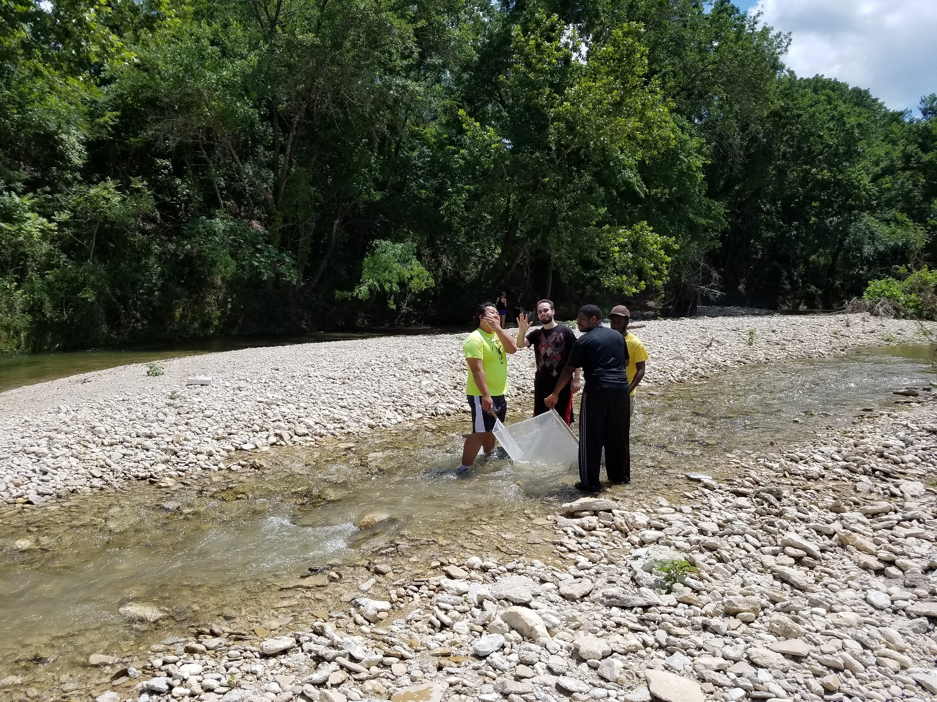
Sample ALL THE THINGS

